Slide 1
How to build an Oracle application: the tools
Quick but not dirty

Slide 2
Agenda
The DOs and DONTs
Steven Feuerstein
Tom Kyte
Data Model
Apex

Slide 3
The DOs and DONTs
RTFM
Don’t (just) listen to gurus
Less (code) is more
KISS
Small is beautiful
Use best practices: document them (1 page?)

Slide 4
Steven Feuerstein
Oracle PL/SQL guru since 1994, very good communicator
Has written books about PL/SQL from Oracle 7 onwards
https://www.stevenfeuerstein.com/
Very interesting: quizzes on https://devgym.oracle.com

Slide 5
Tom Kyte (1)
Oracle guru working for Oracle since 1993
Retired in 2015
Don’t (just) listen to gurus: this is an exception
AskTOM website
Books (still interesting):
Expert One on One Oracle (2003)
Effective Oracle by Design (2003)
Expert Oracle Database Architecture: 9i and 10g Programming Techniques and Solutions (2005)
Expert Oracle Database Architecture: Oracle Database 9i, 10g, and 11g Programming Techniques and Solutions (2010)

Slide 6
Tom Kyte (2)
Tom Kyte's mantra is:
You should do it just using one SQL statement if at all possible.
If you cannot do it in one SQL statement, then do it in PL/SQL.
If you cannot do it in PL/SQL, try a Java Stored Procedure.
If you cannot do it in Java, do it in a C external procedure.
If you cannot do it in a C external routine, you might want to seriously think about why it is you need to do it…

Slide 7
Tom Kyte (3)
From presentation in 2011, Efficient PL/SQL Why and How?

Slide 8
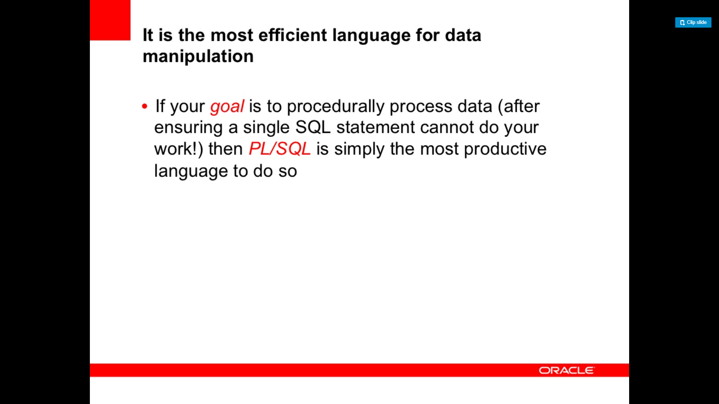

Slide 9
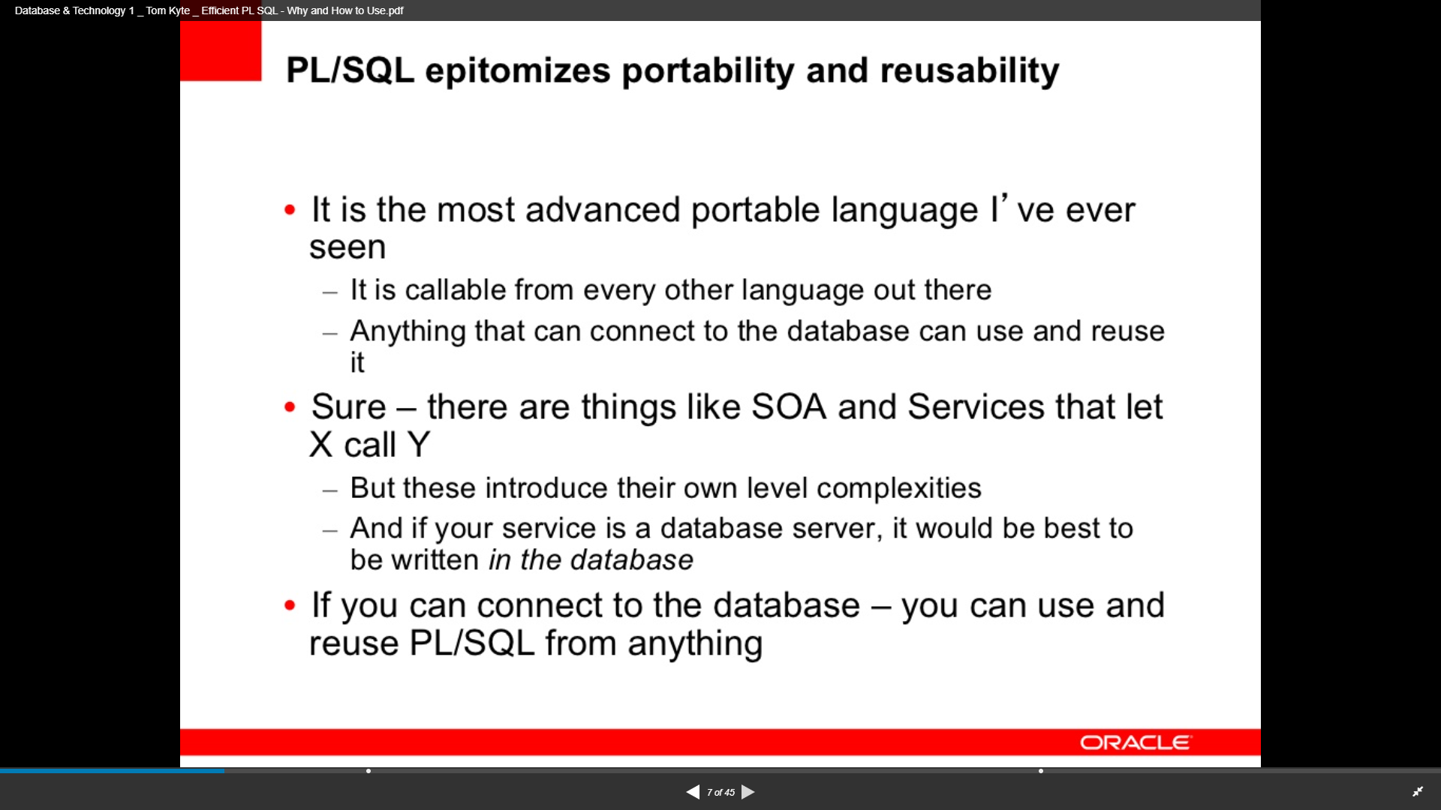

Slide 10
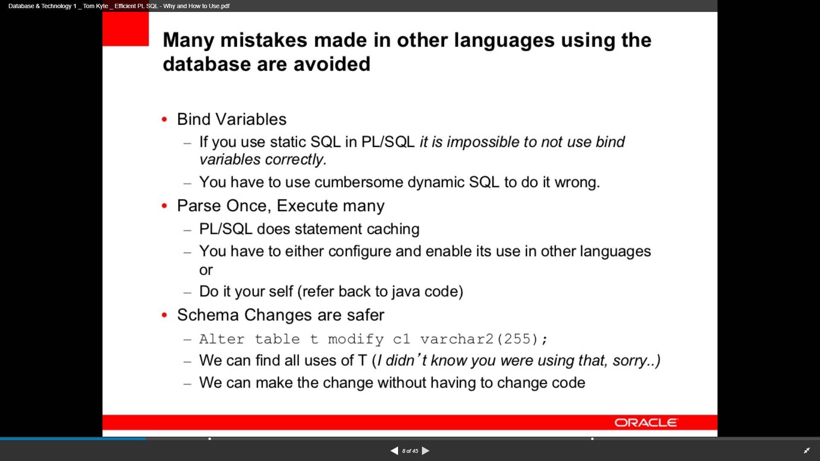

Slide 11
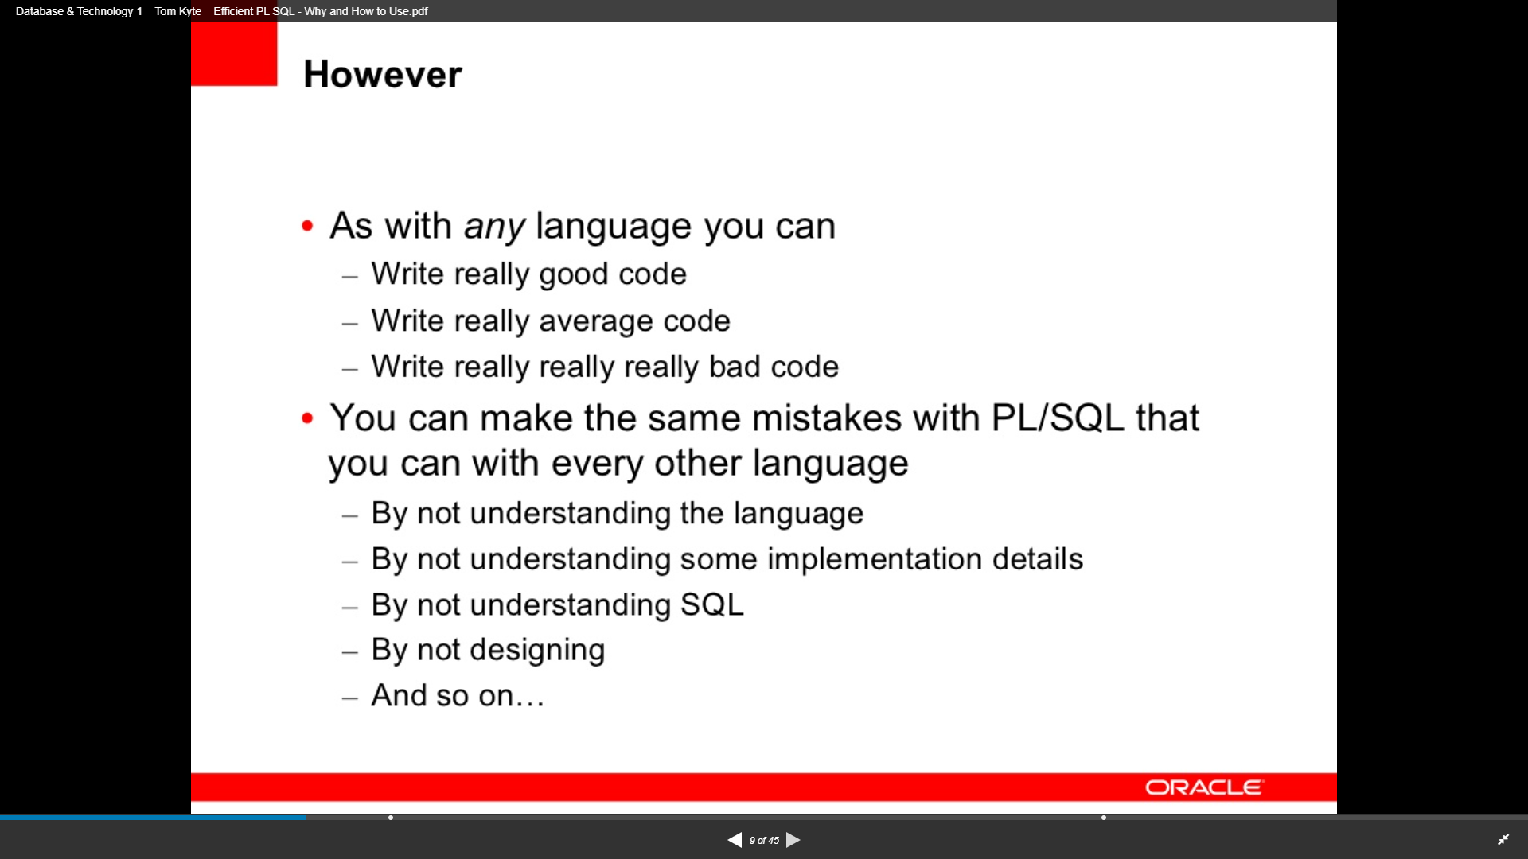

Slide 12
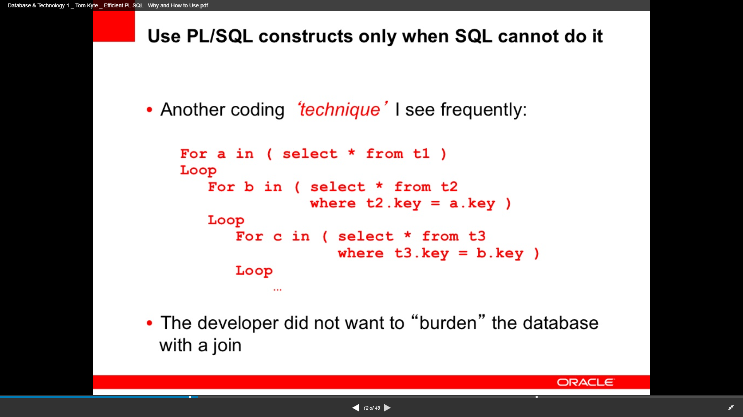

Slide 13
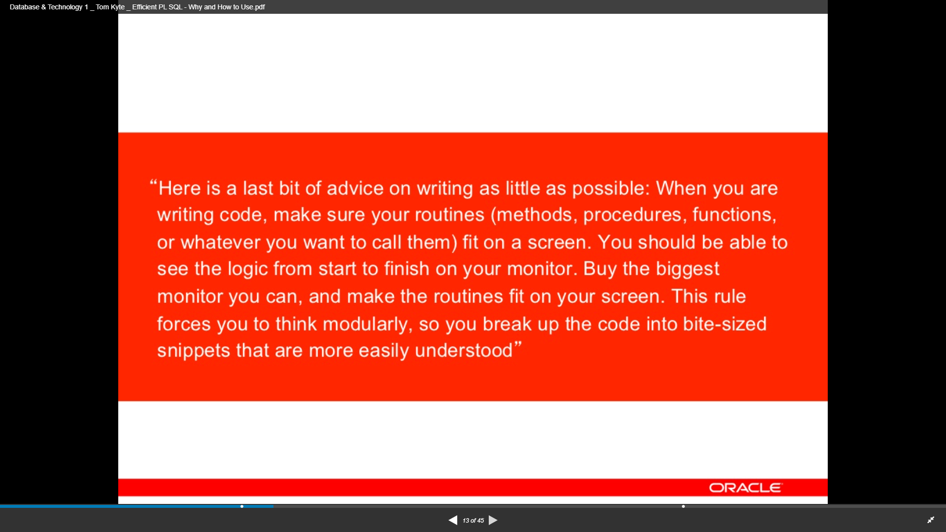

Slide 14
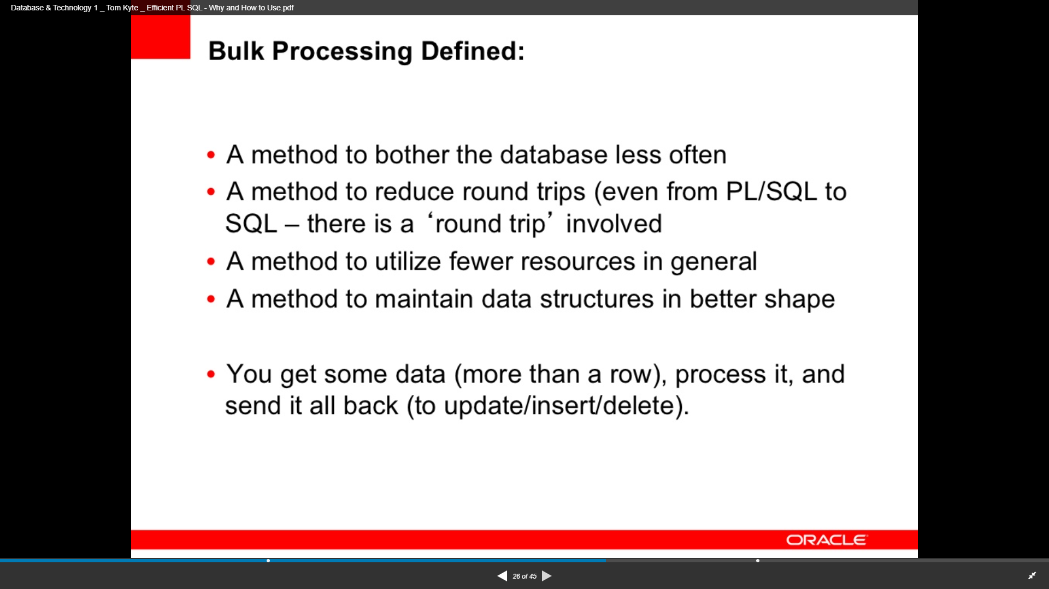

Slide 15
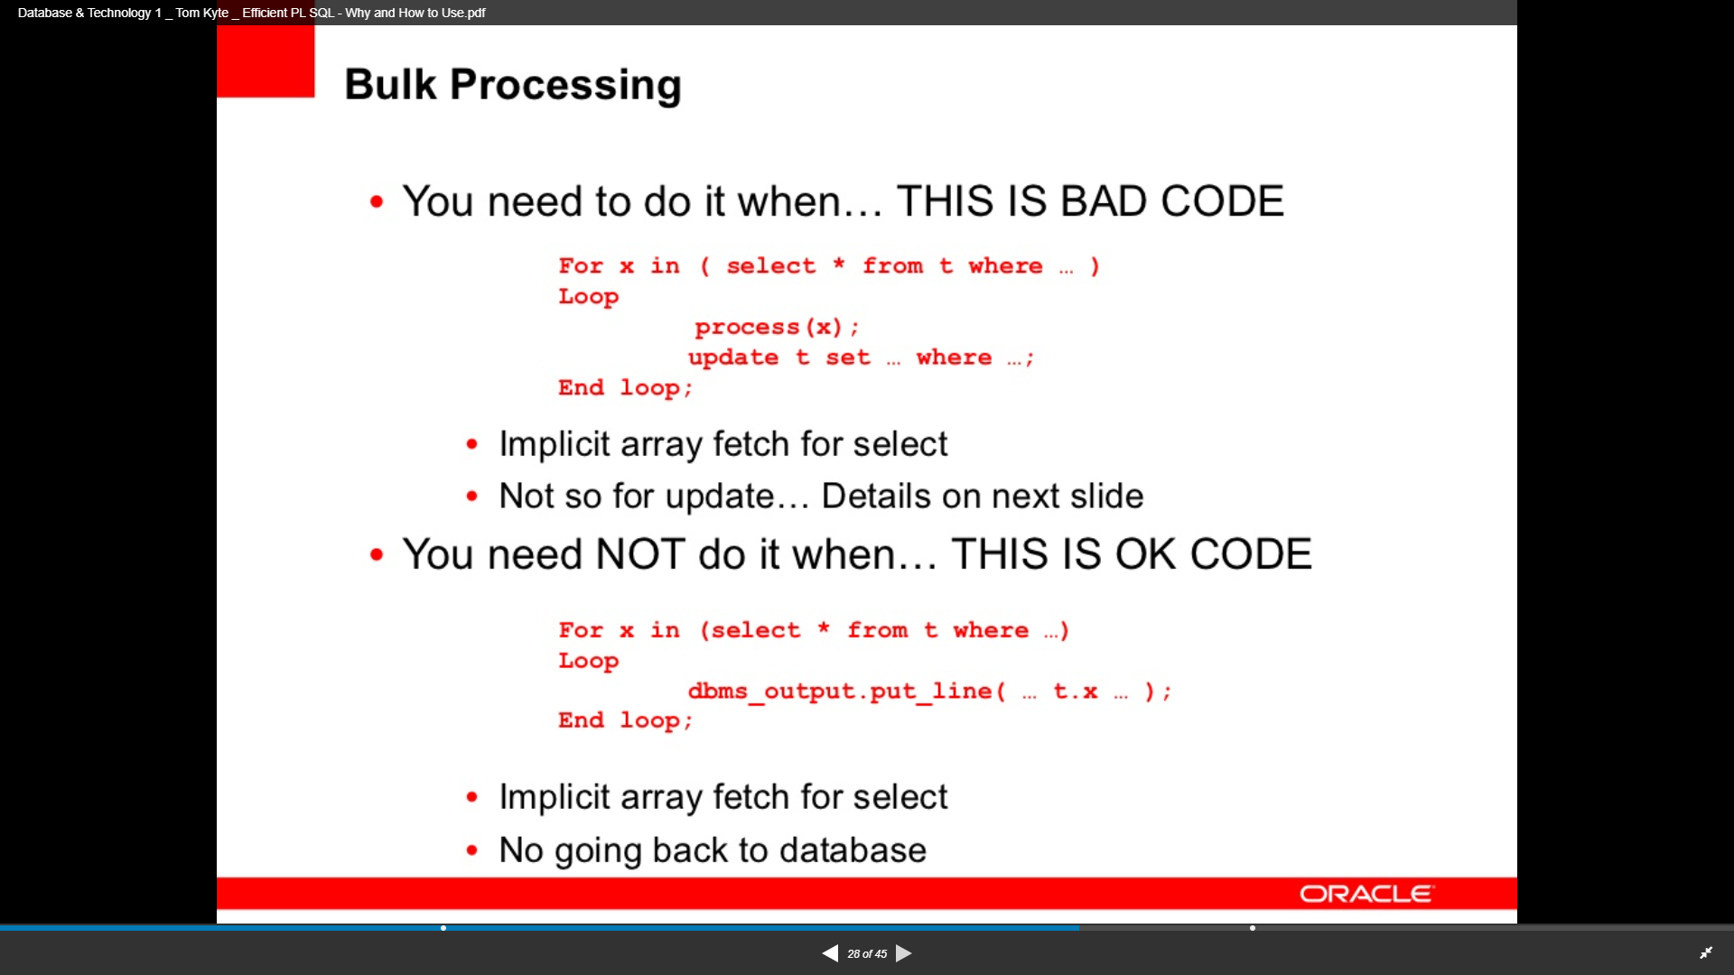

Slide 16
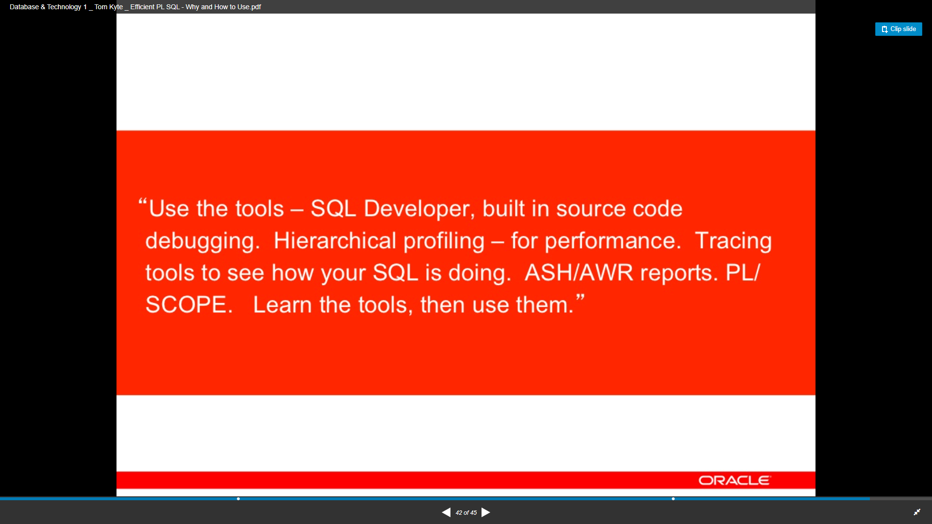

Slide 17
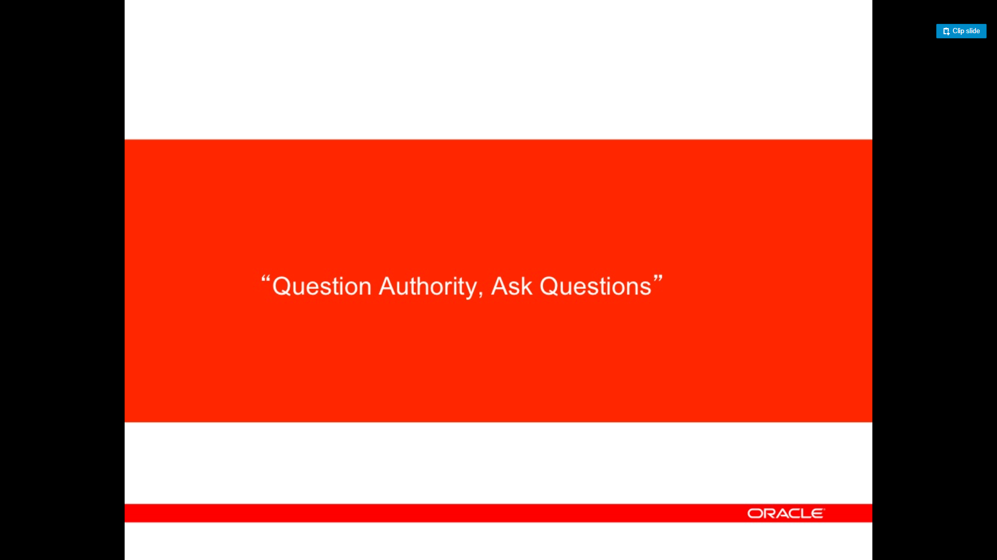

Slide 18
Data Model
Use SQL Developer Data Modeler to:
Define your Entity Relationship Model
Create your tables in the relational model
Define constraints
Create rules to check/modify your model
Create incremental DDL scripts to upgrade your database
Adding columns
Adding constraints
That’s all: no views/stored procedures/etcetera

Slide 19
APEX
Less is more:
The less code (in APEX), the faster
Run-time (less parsing)
Development time (imports/exports)
Impact analysis
Know your tool: use the latest techniques (read release notes)
Clean-up: remove obsolete code, plugins, files
Use the Advisor Utility to improve the quality

